Slide 1


SAP Replication Server What’s New in 15.7 SP200 +
Bill Zhang, Product Management
Lisa Spagnolie, Product Marketing
Q1, 2014

Slide 3
Agenda
SAP Replication Server Overview
Real Time Replication for SAP HANA
High Availability and Disaster Recovery for SAP Business Suite on ASE
Real-Time CDC for SAP Data Services
Key Information Sources

Slide 4
SAP Replication Server Real-time data, delivered reliably, enterprise-wide
SAP Replication Server is a real-time, low-impact, database replication solution with rich enterprise-level features for both SAP and non-SAP databases and applications. It securely, reliably, and rapidly moves and synchronizes data across multiple data sources in real time to deliver:
High Availability/ Disaster Recovery
SAP Replication Server keeps full up-to-the-minute copies of data available and standing by. If primary systems fail, the synchronized replicates take up the workload without interruption.
Real-Time Reporting and Consolidation
With SAP Replication Server delivering consolidated, real-time data to analytics systems, every part of the business can make decisions based on the most current data.
Data Distribution
Data sharing and synchronization enable organizations to leverage all their data across heterogeneous systems, with confidence that it is current and consistent.
Notes:
To start off, I’d like to give you a little background on SAP Sybase Replication Server to set the stage.
At it’s core, Replication Server is a data movement solution. It was designed from the ground up to move and synchronize data from one (or many) primary database sources to one (or many) database targets…in real-time (meaning seconds or even fractions of a second), with virtually no performance effect on the primary source database.
So transactional applications running on the source database never slow down, while all the data changes are being captured behind the scenes from the database log, and quietly moved to secondary sites….to support application high availability, mission-critical disaster recovery, real-time transactional analytics and reporting from a secondary site, and a variety of data distribution solutions.
In the last 20 years, SAP Sybase Replication Server has earned a reputation for being highly secure, reliable, low impact, and blazingly fast.
It benefits businesses by:
Protecting business applications against system downtime – whether planned or unplanned
Supporting accurate decision-making with most current data
Enabling distributed operations within the enterprise
Dramatically improving affordability and efficiency

Slide 5
SAP Replication Server: A Market Leader Proven in mission-critical environments
Leadership, innovation, and proven performance:
First transactional replication tool in the market (1993)
Recognized as an industry leader by Gartner and Forrester
10+ patented technologies that boost performance
More than 4,000 enterprise customers in many of the most data-intensive organizations and industries worldwide
The Replication standard in the financial services industry
SAP Positioned as a “Leader” in Gartner Magic Quadrants for Data Quality and Data Integration¹
¹
Gartner Magic Quadrant for Data Integration Tools, July 2013
Notes:
Over twenty years ago, Sybase developed the product in conjunction with 3 Wall Street giants to quickly and securely distribute data between locations. In fact, it was the 1st transactional replication tool on the market.
Since then, its been put to the test and has been proven in the world’s most demanding environments – including most of the Wall Street financial institutions, most of the US government services – in both civilian and defense agencies, and many of the large retail and logistics companies. These were its proving grounds.
And today, it has grown to over 4,000 customers – across all industries
It’s also one of the products in the SAP data integration offerings that earned a leadership position in the 2013 Gartner Magic Quadrant, and has also been called out by Forrester analysts as well.
And just in the last few years, its received over 10 patents for its performance boosting technology

Slide 6
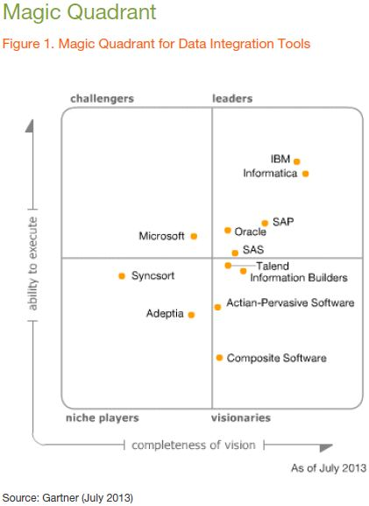
2013 Gartner Magic Quadrant for Data Integration Tools SAP Replication Server part of SAP Leader “dot”
The Magic Quadrant graphics was published by Gartner Inc. as part of a larger research note and should be evaluated in the context of the entire report.
Notes:
And here is the graph from the 2013 Gartner Magic Quadrant for Data Integration, showing SAP in the Leaders quadrant. Something we’re very proud of.

Slide 7
Low Cost of Ownership Simplified deployment & IT administration, high-performance results
SAP Replication Server is an affordable and efficient solution that enables businesses to:
Deploy and manage replication easily – most enterprises can get up and running in one day
Simplify IT administration and maintenance with SAP PowerDesigner
Save money by eliminating the cost of downtime
Seize opportunities and avoid pitfalls with real-time information and analytics
Maximize the value of data assets through consolidation
SAP Replication Server delivers low cost of ownership at every stage, from implementation through day-to-day management, even to expansion. As an off-the-shelf product, it offers streamlined deployment, ease, and predictability.

Slide 8


Product Architecture
Change Data Capture | Replication Engine | Routing & Distribution
Primary
Secondary
In-bound Connectivity(LTL)
Administration & Monitoring
Target DB Connectivity
Replication Agent
Rules Engine
Replication Server
Transformation
Replication Server
Sources*:
SAP HANA
SAP ASE
Oracle
MS SQL Server
IBM DB2/UDB
IBM DB2/OS390
Catalog DB
Targets*:
SAP HANA
SAP ASE
SAP IQ
SAP ESP
SAP Data Services
Oracle
Microsoft SQL Server
IBM DB2/UDB
IBM DB2/OS390
Message Bus
Message Repository
* Please check user documentation for end-to-end source and target database certification

Slide 9








SAP Replication Server Architecture of Common Use Cases
DB High Availability/ Disaster Recovery
Real-Time Reporting/ Consolidation
Data Distribution
Transactional Application(s)
New York
OFF
LINE
Primary Data Center
Oracle
Microsoft
Order Entry
Berlin Operations
IBM
Replication Server
Replication Server
Replication Server
WAN
WAN
LAN
Warm Standby
Reporting & Analytics
Tokyo
New York
London
London Operations
SAP HANA
SAP Sybase IQ
Financial Application
Manufacturing
Sales Support
Notes:
ROI, TO – YOU DON’T HAVE TO LEARN DIFFERENT TOOLS…

Slide 10



SAP Replication Server 15.7 SP200* New features and functions
Real-Time Replication for SAP HANA
HA/DR for Business Suite on ASE*
Real-Time CDC for SAP Data Services*
Real-time data consolidation to SAP HANA for better analytics
Zero Downtime Solution for SAP Business Suite on SAP ASE
Continuous feed to SAP Data Services for real-time ETL
Offloads analytical workloads from both SAP and non-SAP apps running on MS SQL, IBM DB2, Oracle, SAP ASE and SAP HANA to SAP HANA
DDL replication to reduce overhead, maintenance, and downtime
Supports multi-source & target data movement and transactional integrity
Avoid costs and risk of planned and unplanned downtime
Included in the SAP Sybase ASE SAV
New synchronous replication feature ensures Zero Data Loss when moving data to secondary site
Active-Active SAP Business Suite reporting – coming soon
Real-time change data capture (CDC) now feeds SAP Data Services continuously vs batch
Fresher data drives more timely, accurate analytics
Now more streamlined and integrated with SAP Data Services
* These new features will be introduced in series of service packs.
Notes:
Now, with that background covered, I’d like to share a high-level summary of the new features and functions , which have been released or will be released in the next few months, then Bill Zhang will go into more detail on each.
The three primary areas of new functionality support:
Real-time replication for SAP HANA
High Availability & Disaster Recovery for Business Suite on ASE
Real-time change data capture to continuously feed SAP Data Services
For HANA, we can now maximize production database performance and business insights by replicating production data from SAP Business Suite and non-SAP custom apps running on SQL Server, DB2, Oracle, ASE, or HANA…to an optimized reporting and analytics platform, running on SAP HANA. Replication Server allows customers to consolidate data from multiple sources to one or more HANA instances to fit customers’ needs. This is available now.
For Business Suite solutions running on SAP ASE, in addition to the original high availability and disaster recovery solution that basically keeps a secondary site on warm standby with real-time, asynchronous replication to avoid the risk and costs of planned and unplanned downtime. We will be releasing a NEW synchronous replication feature that ensures Zero Data Loss, when the host or the data center is physically damaged. Previously, this Zero Data Loss solutions could only be delivered with expensive, high-maintenance hardware solutions. Now SAP will deliver it in SAP Replication Server software.
And finally, for SAP Data Services solutions, we will be further integrating and simplifying the real-time change data capture functionality that was delivered last year in SP100. This allows Replication Server to move data loading to Data Services – for ETL, profiling, and cleansing – from a batch process to a continuous process. This allows for businesses to run analytics and business intelligence applications on up-to-the-second data – driving timelier, more accurate decision making. This basic functionality is available now, from the last SP, and will be more streamlined and simplified in the next SP coming in the next few months.

Slide 11
Agenda
SAP Replication Server Overview
Real Time Replication for SAP HANA
High Availability and Disaster Recovery for SAP Business Suite on ASE
Real-Time CDC for SAP Data Services
Key Information Sources

Slide 12
SAP Replication Server, HANA Edition Up-to-the-minute data for better decision-making
Mission-critical data often takes 24 hours or longer to reach decision-makers, but SAP Replication Server, HANA Edition delivers up-to-the-second data to SAP HANA for analysis.
SRS replicates transactions into SAP HANA in seconds, enhancing agility of key decision-makers
SRS preserves database and application performance: instead of interacting with the database, it replicates critical transactions from data logs
SRS enhances value of investment in the SAP HANA platform
SAP Replication Server can provide SAP HANA with up-to-the minute data for analysis, helping you make well-informed, time-critical business decisions.
Notes:
SAP Replication Server is the perfect data management solution for SAP HANA deployments. Organizations deploy SAP HANA to achieve real-time performance levels for both transactional and analytical workloads. While legacy data movement tools can limit the timeliness of data available to SAP HANA, SAP Replication Server can provide SAP HANA with up-to-the minute data for analysis, helping you make well-informed, time-critical business decisions. This level of insight helps you seize opportunities, cut costs, grow revenue, and pull ahead of the competition.
SAP Replication Server further amplifies SAP HANA’s performance, allowing you to automatically replicate up-to-the-minute data from multiple data sources into multiple instances of SAP HANA so that you can:
Perform analytics and reporting on current data to identify emerging trends and make smarter, timelier decisions.
Access data from multiple heterogeneous sources from across the enterprise for enhanced analysis and reporting.
Avoid impacting OTLP systems when querying or extracting data for analyses and reports.
Accelerate the performance of existing applications, datamarts, and data warehouses by offloading reporting and analytical workloads to SAP HANA in real time.

Slide 13






SAP Replication Server for SAP HANA 15.7 SP200
Source DB
ECH
WAN
ECH
Source:
SAP HANA
SAP ASE
Oracle
MS SQL
IBM DB2
SAP Replication Server for HANA
SAP Replication Server for HANA
LAN
SAP Replication Server for HANA
SAP Replication Server provides real-time or scheduled transactional replication for SAP HANA
Real time replication solution enables both in-bound and out-bound HANA data movement
Replication Agent for Oracle, ASE, DB2 and MS SQL (RAX) provides non-intrusive, low latency change data capture for both DDL and DML
Replication Agent for HANA (RAH) enables HANA to HANA replication for both DDL and DML, optimized for real time HANA data distribution and reporting
ExpressConnect for HANA (ECH) leverages HANA native driver’s bulk capability for better performance
Support for both SAP Business Suite and non-Business Suite source applications
Heterogeneous direct load materialization (a.k.a. initial load) without downtime
Preserve Transactional Consistency between source and target databases
Flexible Deployment over LAN/WAN, with multiple sources to multiple targets topology
Data Assurance support to ensure distributed data consistency

Slide 14

Heterogeneous Direct Load Materialization (DLM)
Source DB
ECH
SAP ASE
Oracle
MS SQL
IBM DB2
SAP Replication Server for HANA
Direct load materialization optimized for large data volume with zero downtime
Replication to other tables not suspended during direct load materialization
Seamless integration with Replication Server
Integrated with create subscription command to table level replication definitions
Completely eliminate need for manual / bulk materialization
Multiple parallel threads can be configured to load data from one primary table to its corresponding replicate table.
Default # of thread is configured as 5.
Multiple tables can be configured for materialization in parallel.
Build-in monitoring for materialization progress for ease of management

Slide 15
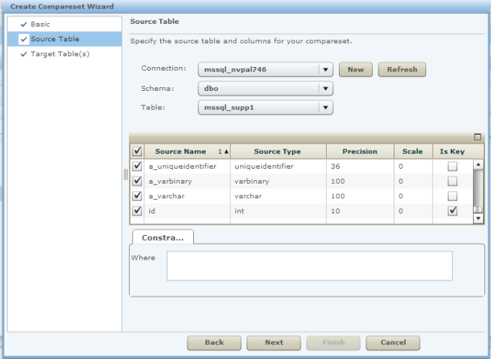



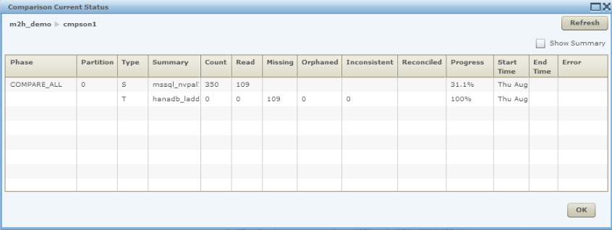



SAP Replication Server Data Assurance for SAP HANA
Ensures data consistency between sources and SAP HANA targets
Highly scalable and can be deployed flexibly to meet high performance and complex topology requirements
Supported database types:
HANA
IQ
ASE
Oracle
MS SQL
IBM DB2
Create CompareSet Wizard
Monitoring Comparison Job
SAP Replication Server - DA
Notes:
Data Auditing use case

Slide 16
Real Time HANA to HANA replication
Replicates data from SAP HANA to SAP HANA, optimized for Replication and Data Distribution
Supports Multiple Replication Modes
Transactional Consistency
Eventual Consistency
Change Data Capture
Transactional Change Data Capture
Highly scalable and parallel task-based execution for both initial load and replication
Captures and replicates both DDL and DML
Notes:
Transactional Consistency
Updates are applied in the same commit order as the Source
Heavier Impact on Source DB
Eventual Consistency
Tables are Scanned Individually Without regard to commit order.
Faster, More Parallel, Minimal Impact on Source DB
Change Data Capture
Only Change Data is Saved
Faster, More Parallel, Minimal Impact on Source DB
Transactional Change Data Capture
Change Data with Transactional Sequencing
Heavier Impact on Source DB

Slide 17

National Basketball Association (NBA) SAP Replication Server delivers up-to-the-second statistics for a better fan website experience
Internal distribution only
AT A GLANCE
Industry
Sports and Entertainment
Region
North America
Licensed Solutions
SAP HANA
SAP Replication Server, SAP HANA edition
Close Date
April 2013
Deal Size
€233K with 8 cores
Partner
SAP Services for SAP HANA
Account Executive
Chris White
CUSTOMER CHALLENGE
Incorporating real-time data from in-progress games into its fan-facing site of statistics from the past 65 years of games
SOLUTION IMPLEMENTATION
NBA and SAP co-innovated to deliver functionality for SAP Replication Server to meet the NBA’s requirements for fast and flexible data movement.
BUSINESS IMPACT
Adds fan-pleasing functionality to the statistics site by including data from in-progress games
Lowers TCO by reducing hardware and software investment
Enables NBA to leverage its expertise in SAP Replication Server, reducing administrative resources needed
Why SAP Replication Server?
It delivers up-to-the-second data to SAP HANA from multiple data platforms with trusted transactional integrity, while minimizing hardware and software requirements and simplifying administration.
INTERNAL USE ONLY

Slide 18
Phillips 66 Optimized pipeline maintenance and pricing strategies —saving more than $2 million in three months
Internal distribution only
AT A GLANCE
Industry
Gas and convenience stores
Region
North America
Licensed Solutions
SAP Afaria
SAP HANA
SAP Replication Server, SAP HANA edition
Close Date
November 2013
Deal Size
€343K with 16 cores
Partner
SAP Services for SAP HANA
Account Executive
Jeff Hart
CUSTOMER CHALLENGE
Optimizing maintenance of pipelines and increasing profitability of retail convenience stores
SOLUTION IMPLEMENTATION
SAP Replication Server team worked closely with Phillips 66 to ensure successful replication of non-SAP data from multiple sources into SAP HANA for real-time analysis of business.
BUSINESS IMPACT
Improved safety and saved money by enabling Phillips 66 to evaluate and optimize maintenance of more than 14,000 miles of pipeline with real-time data feeding SAP HANA-based analytics
Increased total revenue by analyzing and reevaluating gas price discounting strategies
Delivered a 300% ROI in just the first three months based on insights gained from the analytics used in two use cases, more than covering the cost of initial investment in the solution
Why SAP Replication Server?
SAP Replication Server is the only solution that delivers real-time transactional replication from multiple non-SAP data sources into SAP HANA, while maintaining transactional integrity.
INTERNAL USE ONLY

Slide 19
Key Benefits of SAP Replication Server for SAP HANA
SAP Replication Server provides real-time or scheduled, low latency, transactional replication for SAP HANA
Provides real-time replication without performance impact to existing production system for both in-bound and out-bound HANA data movement
Preserves transactional integrity between sources and targets by capturing both Data Modification Language (DML) and Data Definition Language (DDL)
Allows flexible deployment over LAN/WAN, with multiple sources to multiple targets for deployment topology
Build-in Data Assurance capability to ensure consistency of distributed data

Slide 20
Agenda
SAP Replication Server Overview
Real Time Replication for SAP HANA
High Availability and Disaster Recovery for SAP Business Suite on ASE
Real-Time CDC for SAP Data Services
Key Information Sources

Slide 21
Zero Downtime for SAP Business Suite on SAP ASE Keep SAP Business Suite applications up and running
SAP Replication Server’s disaster recovery (DR) capability is optimized to work with SAP Business Suite applications on SAP ASE
Included with an existing SAP ASE runtime license
Simplifies setup and configuration of an SAP Business Suite DR environment; fully integrated into the SAP Business Suite tooling (e.g. DBA cockpit, installer, SAP host control, etc.)
Seamless, automated DR and failover process
Automates failover process for planned and unplanned events
Comprehensively monitors replication performance
IDC report shows SAP ASE saves companies 60 hours annually in planned downtime compared to competitive databases – thanks to SAP Replication Server.³
³
IDC Report: Calculating the True Cost of Ownership
Notes:
The HADR feature supports seamless planned failover from primary to standby servers to avoid downtime during:
System disruptions
Rolling upgrades
Maintenance (hardware, OS, software)
At steady state, active replication flows from primary to standby systems
Either one or two SAP Replication Servers can be deployed based on topology requirements
DR Agents can initiate site failover and failback for planned or unplanned downtime
Based on an extensible SAP Replication Server architecture rather than simply automating database transaction log backup and restore.

Slide 22




SAP Business Suite on ASE and SAP Replication Server
Big Picture
Embedded analytics for business insight and control
Harmonized UI across all applications and processes for increased end-user productivity
SOA enablement for process flexibility and business agility
SAP Business Suite
SAP NetWeaver Composition
End-to-end process for increased business and IT efficiency
Industry best practices for improved performance in core process in all lines of business
Enhancement packages for bringing non-disruptive innovation for SAP Business Suite
Ecosystem solution
Business partners’ solution
Custom solution
CRM
SRM
SCM
PLM
ERP
EhP
EhP
ASE reduces total cost of ownership with high performance and scalability
Replication Server reduces business risk through synchronous replication to provide Zero Data Loss and High Availability
Replication Server provides an active DR database for ABAP reporting to improve primary database performance
SAP ASE DATABASE
SAP REPLICATION SERVER

Slide 23
HA/DR for SAP Business Suite on ASE Feature Overview
The High Availability and Disaster Recovery (HA/DR) feature for SAP Business Suite on ASE provides integrated support for SAP Adaptive Server Enterprise (SAP ASE) and SAP Replication Server (SRS) configuration for High Availability and Disaster Recovery.
The HA/DR feature supports seamless planned and unplanned failover from the primary site to the standby site for
Rolling Upgrade
Maintenance (hardware, OS, software)
High Availability
Disaster Recovery
HA/DR infrastructure consists of a group of SAP ASEs – one designated as the primary server (on which all transaction processing takes place) and others as standby servers (which act as warm standby for the primary server). SAP Replication Server keeps standby ASE servers in sync with the primary ASE server.

Slide 24
SAP Replication Server – Replication Management Agent (RMA) Capabilities
RMA (replication management agent) provides interface to configure and manage ASE and SRS for HA/DR.
Simplifies the setup of a Business Suite HA/DR environment
Consolidate the steps required to produce the environment
Produce a standard replication configuration
Supports servers configured on separate hosts
Integrate with the Business Suite’s SAP Installer, DBA Cockpit, DBCntrl
Automates the failover process
Reverse the direction of replication
Support both planned and unplanned events
Provide solutions for different recovery scenarios
Integrate ASE HADR to control database access
Monitors replication
Availability of servers, connections, and routes
Replication Latency
Resource utilization

Slide 25
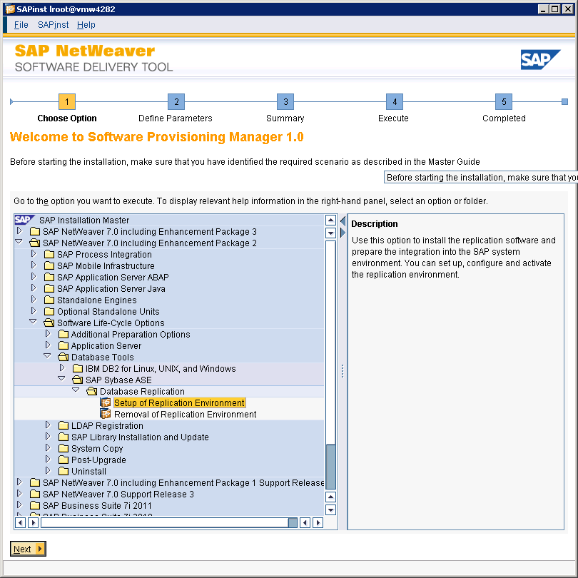
Replication Setup in SAP Installer
Installation steps:
Select “Setup of Replication Environment” from product catalog

Slide 26
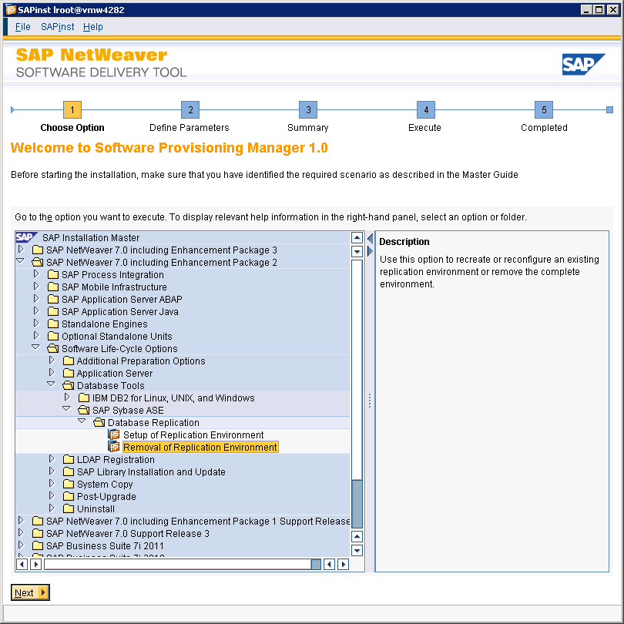
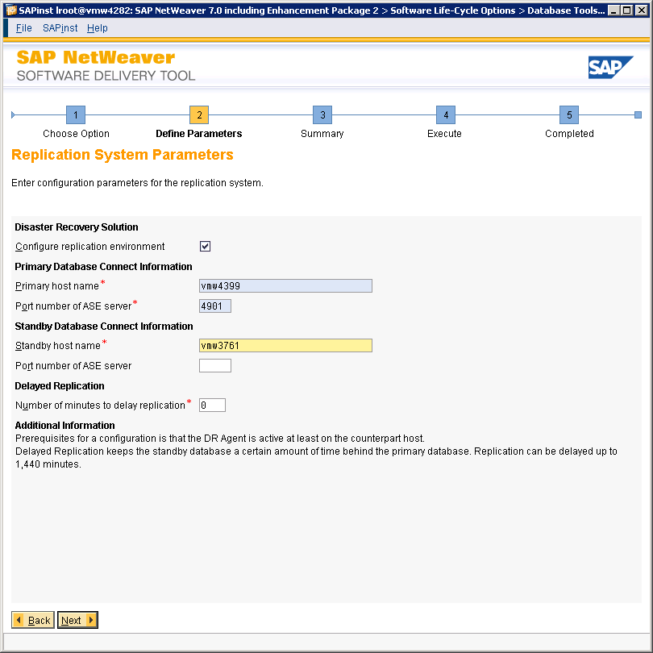
Replication Setup
Installation steps:
Select “Setup of Replication Environment” from product catalog
Choose installation mode (typical)
Enter SAP profile directory
Specify default password for OS and DB users
Configuration of replication environment
On standby: deselect configuration SRS / RMA is ready for installation now – no further screens
On primary: enable configuration specify standby ASE connection details
Always set up standby first and then primary

Slide 27
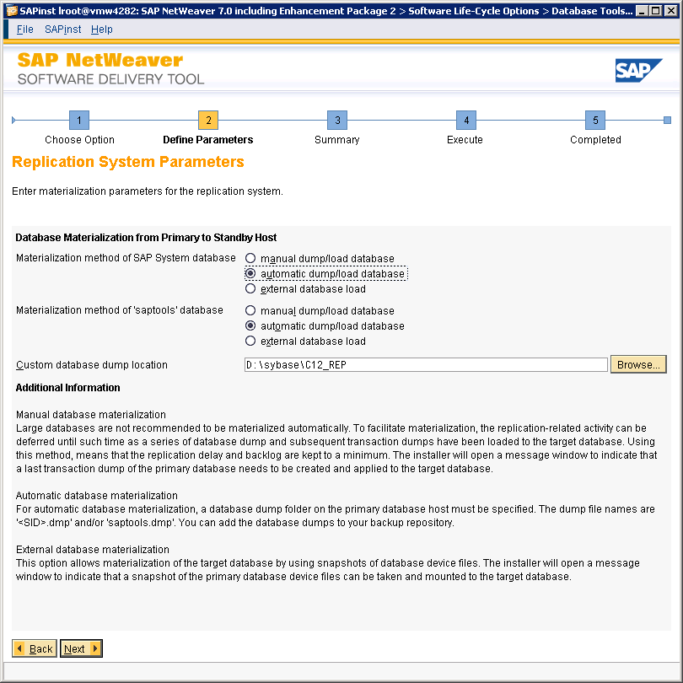
Choose Materialization Method in Replication Setup
Installation steps:
Select “Setup of Replication Environment” from product catalog
Choose installation mode (typical)
Enter SAP profile directory
Specify default password for OS and DB users
Select configuration, enter standby ASE connection details
Choose materialization method

Slide 28
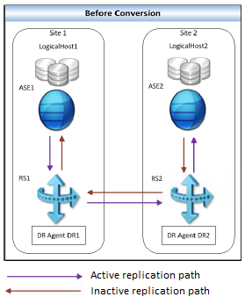
Cascade and Asynchronous Replication (default)
The Initial topology generated by the SAP Installer
Cascading replication – distributes data locally (ASE1 > RS1 > RS2 > ASE2)
Asynchronous – ASE does not wait for RS acknowledgement before commit
Notes:
In the asynchronous mode, ASE does not wait for acknowledgement that
Replication Server has received and stored the transaction before Adaptive Server commits
the transaction.
Adaptive Server commits a transaction after flushing the transaction to the Adaptiver Server
database transaction log. Whether Adaptive Server RepAgent can or will send the transaction
to Replication Server is independent of the transaction commitment in Adaptive Server.

Slide 29
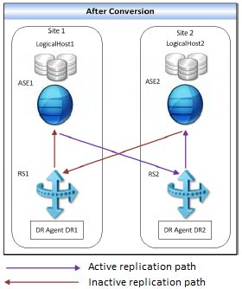
Synchronous – Remote and Synchronous Replication
Switch Cascade/Asynchronous to Remote/Synchronous via sap_update_replication command
Remote replication – distributes data remotely (ASE1 > RS2 > ASE2)
Synchronous – ASE only commits a transaction after writing the transaction to the DB transaction log and receiving RS acknowledgement that the transaction was written to the SPQ
Notes:
In the synchronous mode, Adaptive Server only commits a transaction after writing the
transaction to the Adaptiver Server database transaction log and after receiving
acknowlegement that Replication Server has received and written the transaction to SPQ.
Compared to the asynchronous and near-synchronous replication modes, in the synchronous
mode, applications have to wait longer for transactions to be committed because
Adaptive Server can only write the transaction to the database log after Replication Server
acknowledges writing the transaction to the SPQ.

Slide 30

Synchronous Replication Internal Overview
Replication Server
EXEC
ASE
To DIST
IBQ
CI-lib
Component Interface
capture
native
threads
Replication Agent
TCP/IP
Replication mode can be configured as Sync, Near-Sync and Async
Sync: ASE only commits a transaction after writing the transaction to the ASE log and after receiving ACK that RS has received and written the transactions to stable queue
Near-sync: ASE only commits a transaction after writing the transaction to ASE transaction log and after receiving ACK that SRS has received the transaction
Async: ASE doesn’t wait for ACK that SRS has received and stored the transaction before ASE commits the transaction
SPQ

Slide 31

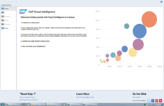
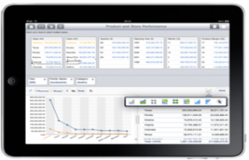
Report off-loading to DR Site for SAP Business Suite on ASE* (Active-Active configuration)
Replication Server provides an active standby database for ABAP reporting
Improve primary database performance by re-directing DSS workload to active standby database
Lower TCO by utilizing standby software and hardware at DR site
SAP Business Suite ABAP reporting from standby database
SAP Business Suite
Business Suite Accelerator
Primary Server
Active Standby Server
Primary Replication Path
Standby Replication Path
* Scheduled for Mid-2014 release

Slide 32
Key Benefits of SAP Replication Server for Suite on ASE
SAP Replication Server automates HA/DR configuration and manages failover process and monitors replication performance
Simplify setup and configuration of a SAP Business Suite high availability and disaster recovery environment
Provide HA & DR for Suite on ASE with common SRS infrastructure
Achieve Zero Data Loss (ZDL) with synchronous replication
Leverage active standby ASE database for ABAP reporting

Slide 33
Agenda
SAP Replication Server Overview
Real Time Replication for SAP HANA
High Availability and Disaster Recovery for SAP Business Suite on ASE
Real-Time CDC for SAP Data Services
Roadmap
Key Information Sources

Slide 34
SAP Replication Server, Change Data Capture Edition Single, integrated solution for better business intelligence
Provides a single solution for real-time CDC, complex data transformation, and data quality management for the end-to-end enterprise. With SAP PowerDeisgner, no need to write manual code – saving time, reducing administrative costs, and eliminating errors.
SAP Replication Server – Low impact, low latency, and real-time CDC
SAP Data Services – Complex transformation and data quality
SAP PowerDesigner – Enterprise modeling and runtime generation
Pension fund giant Grupo Sura uses SAP Replication Server, CDC Edition and SAP Data Services to identify cross-selling opportunities as they occur.
Notes:
Message for existing SAP Data Services customers:
Enrich batch data processing with real-time source data changes, including real-time data delivery, zero fault tolerance, and zero operational downtime
Message for existing SAP Replication Server customers:
Data replication and synchronization across the enterprise combined with advanced-level data transformation and data quality capabilities

Slide 35
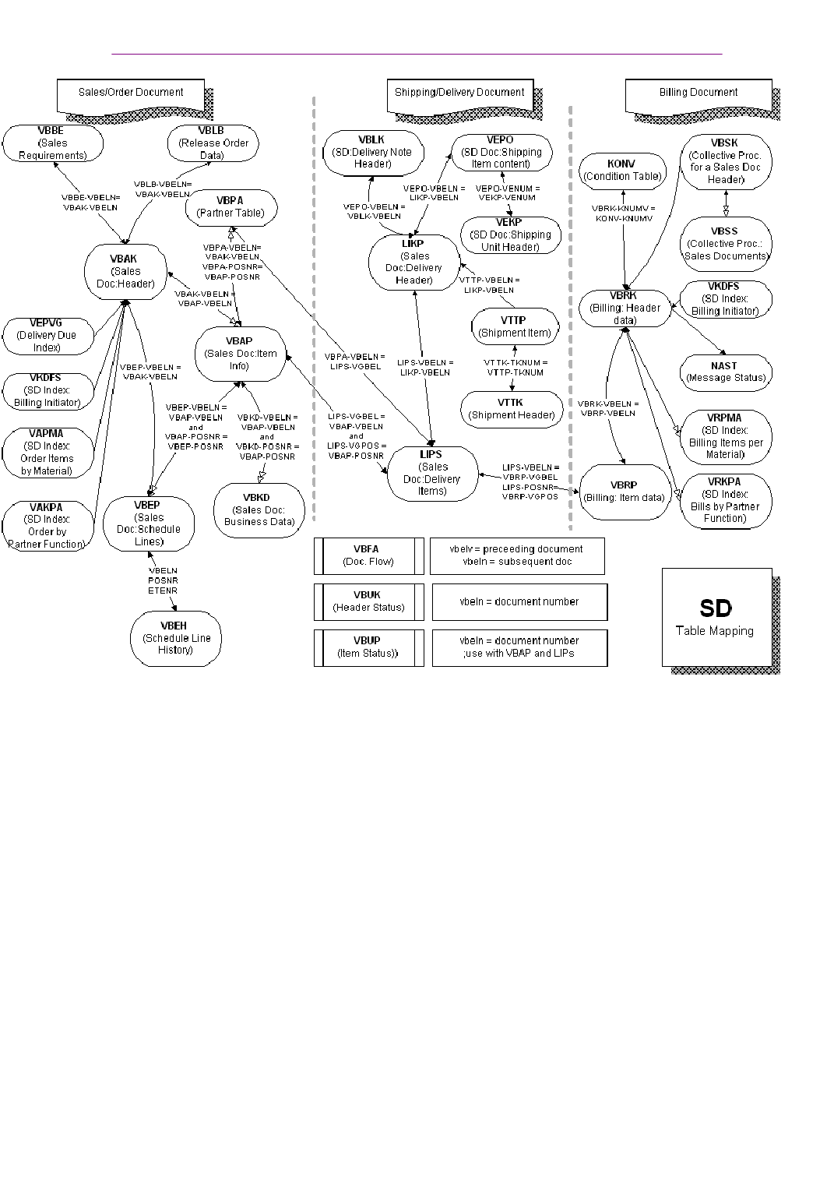

Real-Time Change Data Capture for SAP Data Services
SAP Replication Server + SAP Data Services
Single solution for real-time Change Data Capture (CDC) complex data transformation and data quality management
Turn complex operational data into business user consumable information in real-time
Improve business performance with the right data for real-time BI analytics and applications
Complex Operational Data
Real-Time Applications
Notes:
Elevator Speech: With this capability, we provide customers with a single solution for real-time data purposing for both SAP ERP and not-SAP data by integrating DS with SAP SLT and Sybase Replication Server (for CDC), turning operational data into the right data for business user consumption in real-time BI analytics and applications necessary to achieve improve business performance.

Slide 36


Single, Integrated Solution for Better Business Intelligence
Provides a single solution for real-time change data capture (CDC), complex data transformation and data quality management with end to end enterprise modeling without staging database.
Source DB
SAP Sybase ASE
Microsoft SQL Server
IBM DB2/UDB
Oracle
SAP Replication Server
SAP Replication Server: low impact, low latency, real time change data capture
SAP Data Services: complex transformation & data quality
Unified management console to simplify administration and performance monitoring

Slide 37


Real-time CDC for Data Services Process Flow
1
3
4
Changes to myCustomer table in Oracle database, such as: 1) adding new contacts 2) modifying existing contacts, are executed
Transient CDC data is stored within SRS’s in-memory data structure
SAP Data Services retrieves CDC data from SRS in-memory data structure to: 1) perform Data Quality or Transformation 2) update the CustomerMaster table
SAP Replication Server
MyCustomer (Oracle)
CustomerMaster (ASE)
2
Data modifications to MyCustomer table are captured in real-time by SAP Replication Server
Notes:
This graphic represents a sample real-time Change Data Capture dataflow use case scenario:
User wants to update changed data from a source table, such as MyCustomer, in an Oracle database.
Using the Replication Server log-based mechanism, changed data are captured in realtime.
Replication Server stores the changed data from the source table to a runtime database.
Data Services can set up to retrieve the changed data continuously from the runtime database for complex transformation and data quality operations before loading to the target system.
PowerDesigner is used to configure the setup from the source table to Replication Server and generates the runtime models between Replication Server and the runtime database.

Slide 38
SAP Data Services Process Flow
Configuration:
SAP Data Services setup to retrieve CDC data from SRS
CDC Dataflow Design
Use of continuous workflow
CDC Data Retention
Purging of old CDC data from runtime database
Notes:
There are three areas focused around Data Services for the integrated solution:
Configuration of CDC datastore and import table in Data Services
CDC dataflow design - If there is a requirement to pull CDC data continuously, not using a scheduling method, users can design the CDC processing flow using Continuous WorkFlow.
CDC data retention - after CDC data is processed, the integrated solution will also handle the purging of CDC data in the runtime database.

Slide 39
Key Benefits of Real-Time CDC for SAP Data Services
Provides end-to-end solution of real-time, continuous change data capture, combined with complex transformation and data quality for better business intelligence solutions
Existing SAP Data Services customers:
Enrich batch data processing with real-time source data changes, including real-time data delivery, zero fault tolerance, and zero operational downtime
Existing SAP Replication Server customers:
Data replication and synchronization across the enterprise combined with advanced-level data transformation and data quality capabilities
Notes:
For existing Data Services customers, real-time data provisioning enriches batch data processing with real-time source data changes. For existing SAP replication customers, real-time data provisioning provides data replication and synchronization across the enterprise.

Slide 40
Agenda
SAP Replication Server Overview
Real Time Replication for SAP HANA
High Availability & Disaster Recovery for SAP Business Suite on ASE
Real Time CDC for SAP Data Services
Key Information Sources

Slide 41
Key Information Sources
Web Pages:
SRS @ SCN: http://scn.sap.com/community/sybase-replication-server
SRS Roadmap @ SAP Service Marketplace: http://service.sap.com/roadmap
SRS @ SAP Community Network: https://community.wdf.sap.corp/community/dbms/srs
SRS – Key Documents and Links
SAP Replication Server Overview (SCN)
Getting Started
Quick Start Guide for SAP HANA Database
Design Guide
Heterogeneous Replication Guide
SAP Note 1978251, for HADR user guide for Suite on ASE

